Slide 1
NC-SARA - Welcome
Welcome to the NC-SARA Webcast
SARA Notification Requirements
– Still Required!
June 10, 2019
Please Note:
The webcast will begin at the top of the hour.
There is no audio being broadcast at this time.

Slide 2
NC-SARA - Logistics
Welcome!
Please use the chat box for questions.
The PowerPoint and any other resources will be available next week.
The webcast will be recorded and available on the NC-SARA Website.

Slide 3
Presenters
Marshall A. Hill, Ph.D.
President, NC-SARA
Mary Larson, M.Ed.
Associate Director, NC-SARA
Marianne Boeke, Ph.D.
Associate Director, NC-SARA

Slide 4
Agenda
The Current SARA Landscape
Why does SARA have a notification policy?
What types of institutional programs must provide notifications?
What are the required elements surrounding the notifications?
How do federal regulations impact SARA notifications?
Questions and Discussion

Slide 5
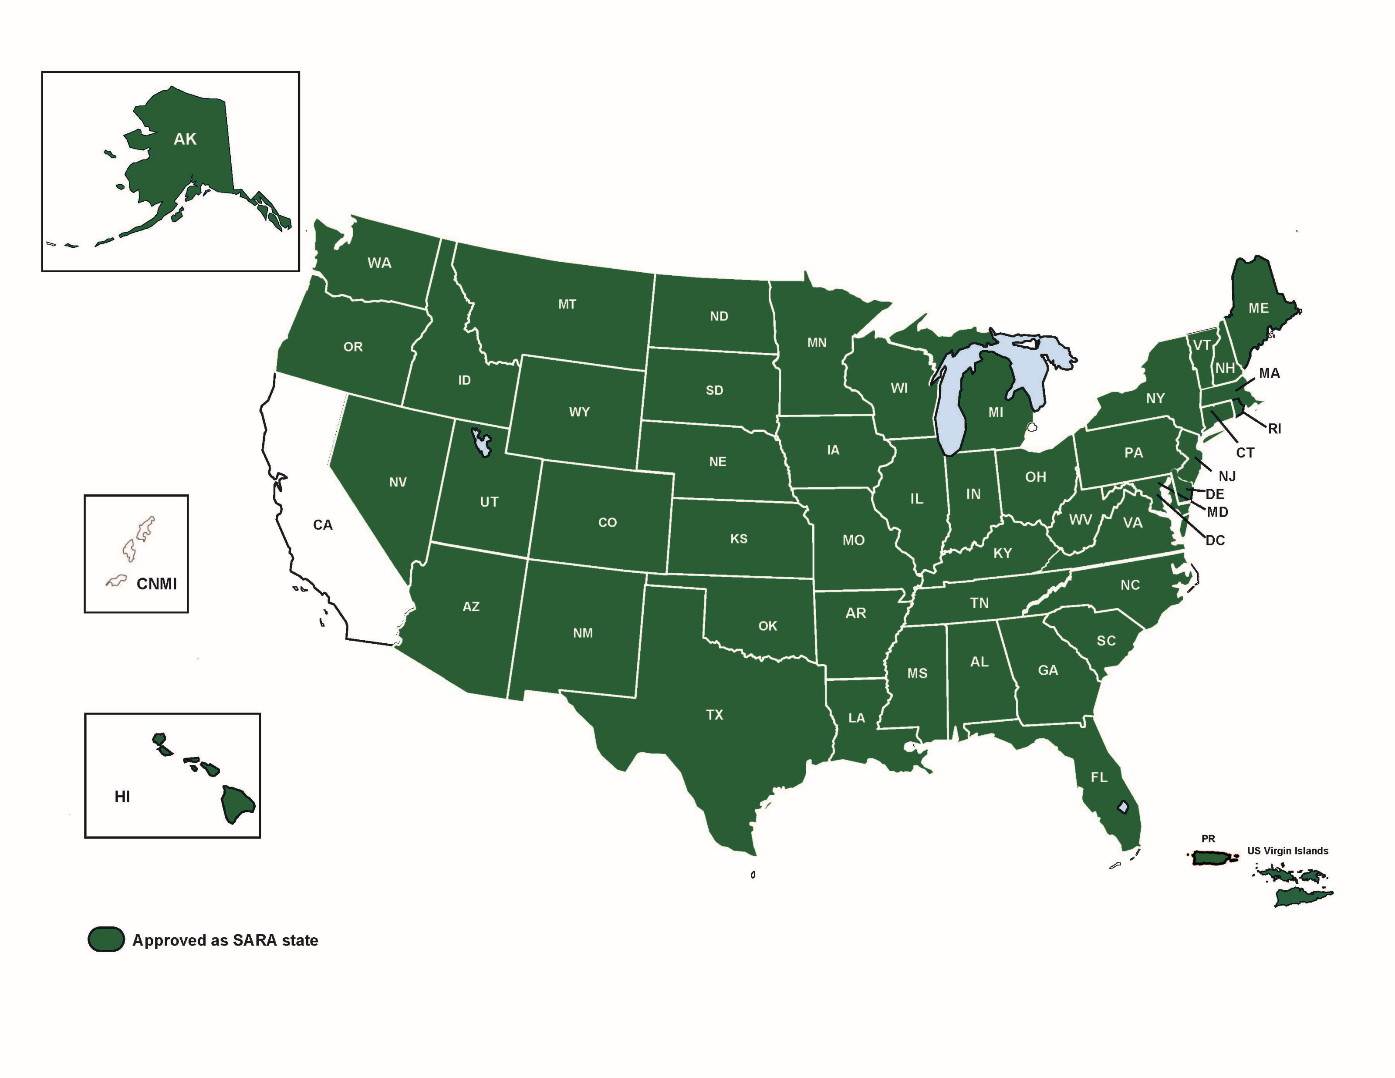
SARA Requirements The Current SARA Landscape
52 Members in SARA
49 states, the District of Columbia
Puerto Rico, and the US Virgin Islands
1965 participating institutions
- May 2019
Notes:
Puerto Rico is expected to submit their SARA application to SREB this Spring.
Massachusetts's is expected to submit their SARA application to NEBHE this Spring.
California will need to have legislation passed prior to submitting their SARA application to WICHE

Slide 6
SARA Requirements - States
States are members of SARA – they agree to:
Follow uniform processes for approving their eligible institutions' participation in SARA.
Deal with other states' SARA institutions in a common way.
Have a comprehensive state process for consumer protection in regard to SARA activities.
Designate of a “lead entity” to coordinate SARA policies for the state.

Slide 7
SARA Requirements - Institutions
Institutions are participants in SARA – they agree to:
Follow SARA policies.
Abide by the C-RAC Guidelines.
Be responsible for the actions of any third-party providers.
Work with its home state’s SARA portal entity to resolve any student complaints.
Provide data necessary to monitor SARA activities.
Notify in writing all students in a course or program that customarily leads to professional licensure.

Slide 8
SARA Notifications - Required
SARA Notifications are REQUIRED
Why does SARA have a notification policy?
Where do I find information about required notifications?
SARA Institutional Application (initial & renewal) #10
Agree to notify in writing
SARA Manual – June 1, 2019• Version 19.2
Section 5.2

Slide 9
SARA Notifications – Big Picture
What types of institutional programs must provide notifications?
Notifications for courses or programs potentially leading to professional licensure.
Are NC-SARA notifications for distance education students only or for all students?
Distance education activities covered by NC-SARA include out-of-state experiential learning placements for students who are taking face-to-face courses on their home campuses.

Slide 10
SARA Manual Version 19.2 – 5.2 -Who to Notify
Who do institutions need to notify?
Any institution operating under SARA policies that offers courses or programs potentially leading to professional licensure or related to post-licensure educational activities must keep all students, applicants and potential students who have contacted the institution about the course or program informed as to whether successful completion of such offerings would actually meet state licensing or post-licensing requirements.
For purposes of SARA, this must be done in one of two ways:

Slide 11
SARA Manual Version 19.2 – 5.2 -How to Notify
The institution may determine whether the course or program meets the educational requirements for professional licensure in the state where the applicant or student resides and provide that information in writing to the applicant or student.
If unsuccessful (after making all reasonable efforts to make such a determination) the institution may notify the applicant or student in writing that the institution cannot confirm whether the course or program meets educational requirements for professional licensure in the student’s or applicant’s state, provide the student or applicant with current contact information for any applicable licensing boards, and advise the student to determine whether the program meets requirements for licensure in the state where the student is located.

Slide 12
SARA Notifications – Required Elements
What are the required elements surrounding the notifications?
Institutions must keep all students, applicants, and potential students informed as to whether such offerings actually meet state licensing requirements.
Notify students in writing.
Email to the last known address.

Slide 13
SARA Notifications – How Often?
How often should an institution be sending out updates on notifications?
For the purposes of SARA once a student has provided the institution with the state they wish to practice in, then unless the student notifies the institution of a change in the state, the institution would provide initial written notification.
Follow-up communications should be made if the institution becomes aware of changes that would affect the student’s ability to pursue and/or obtain licensure.
HOWEVER, that is strictly for the written notification requirement; it does not cover the consumer protection requirements for marketing, website, etc. The institution should be updating and verifying information as circumstances change, and at least yearly as a best practice.

Slide 14
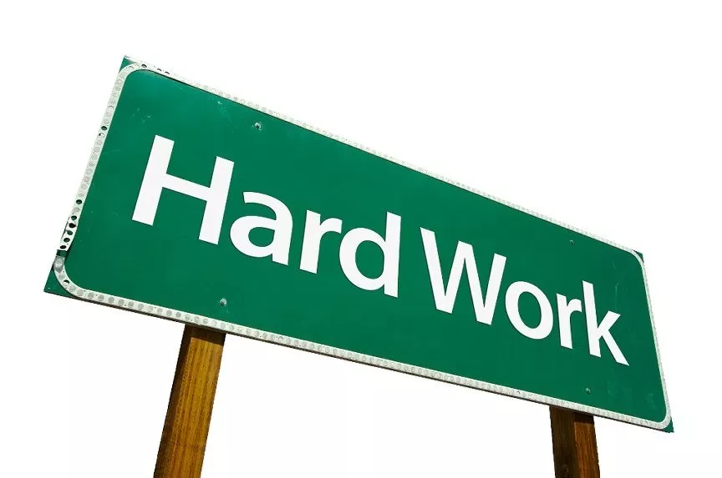
SARA Notifications – Hard Work
But what if certain licensure boards are not responsive to my questions?
Read the SARA manual and application.
Make all reasonable efforts to make a determination.
Inform the applicant/student in writing that a determination could not be made.
What should an institution do, if they can
not make a determination?

Slide 15
SARA Notifications – If an Institution Can Not Make a Determination
What should an institution do?
Provide the applicant/student the contact information for the appropriate state licensing board(s).
Advise the applicant/student to determine whether the program meets requirements for licensure where the student is located.
An e-mail dedicated solely to this purpose and sent to the applicant/student’s best known e-mail address meets this requirement.

Slide 16
SARA Notifications – No Contact List
What should an institution do in terms of notifications for those potential students who once contacted the institution, but are now the “do not contact” list?
“Do not contact” lists are not discussed directly in the SARA Manual
Institutional staff (including the institution’s legal team) may want to review the wording of their “do not contact” list. Does the wording state that absolutely no contact shall be made? Does the wording imply that only substantive information (including academic requirements) may be sent to the student? After a review of said document a policy determination may be made and then followed by the institution.

Slide 17
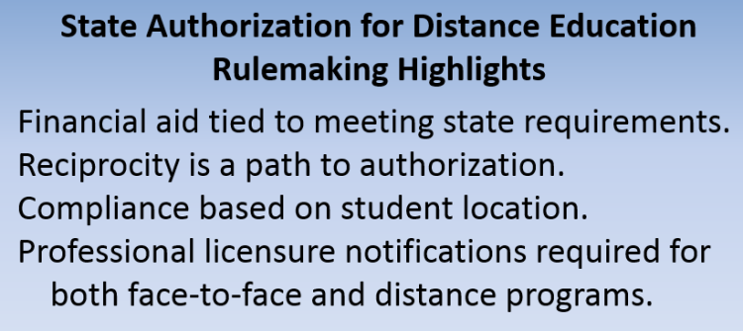
Negotiated Rulemaking - Highlights

Slide 18
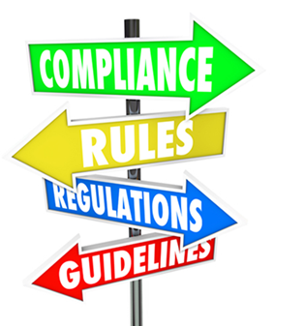
Federal Regulations & Negotiated Rulemaking
State Authorization reciprocity agreement definition returns to the language provided in the 2016 regulations.
…that a state authorization reciprocity agreement is an agreement between states to provide educational activities in the other participating states as directed by the agreement.

Slide 19
Negotiated Rulemaking – Professional Licensure
34 CFR §668.43 Professional Licensure
Proposed language
Lots of moving parts…
Big change - an institution must provide notifications to all students in programs leading to professional licensure, regardless of modality, whether completion of the program will meet educational licensure requirements in a state for that occupation.
https://wcetsan.wiche.edu/sites/default/files/files/2019-04/Consensus%20668%204-3-19.pdf

Slide 20
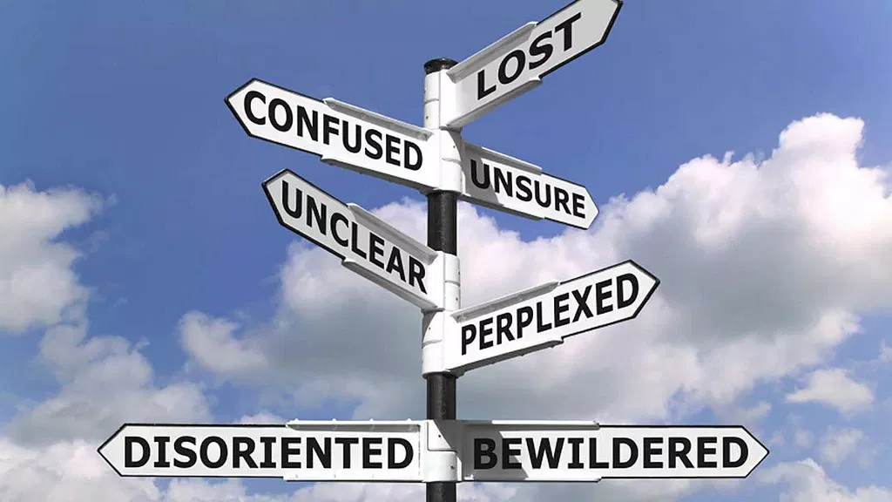
SARA Notifications – What If I am Still Confused?
What if I am still confused or need more help/details?
Institutional Application
SARA Manual
Your SARA State Portal Entity
Your SARA Director (Regional Compacts)
NC-SARA Staff

Slide 21
SARA Notifications – Frequently Asked Questions
How do federal regulations impact SARA notifications?
My state Attorney General (or university attorney) thinks we should do something different? For example… should an institution communicate that a program WILL meet licensing requirements in a state or states other than the home state? The attorney may feel that the risk of requirements changing at any time is too great.
Are NC-SARA notifications for distance education students only, or for all students (including face-to-face)?
What is the difference between a license and certification – in terms of NC-SARA requirement for notification?
What about graduate work? Do we have to have notifications for those programs as well?

Slide 22
Questions and Discussion

Slide 23
Resources
Marshall A. Hill
mhill@nc-sara.org
Mary Larson
mlarson@nc-sara.org
Marianne Boeke
mboeke@nc-sara.org
For Questions: Info@nc-sara.org
NC-SARA Website: www.nc-sara.org

